Slide 1
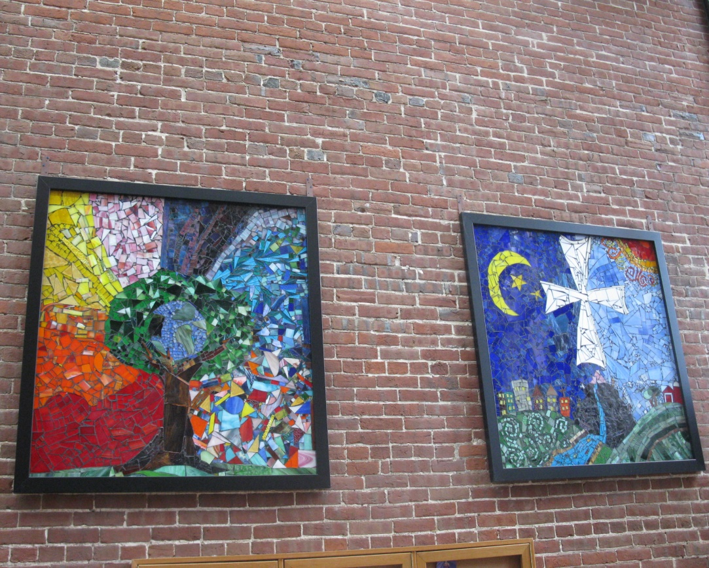
Proposed Budget Report Fiscal Year 2014
The Gospel for Tomorrow
Episcopal Diocese of Central Pennsylvania

Slide 2
Proposed Budget Report The Gospel for Tomorrow
Key Elements
Reorganization of the diocese to reflect increased responsiveness to the ever-changing demands of ministry in the 21st Century.
Implementation of an outcomes based planning process that includes ongoing measurement and effectiveness evaluations for all aspects of diocesan mission and ministry.

Slide 3
Proposed Budget Report The Gospel for Tomorrow
Assumptions
Decreasing resources at the parish level have a direct impact upon the capacity of the diocese to provide services above and beyond its core activities.
Reflecting the circumstances of the church at the parish level, diocesan commissions and councils must frequently make difficult choices concerning how resources will be allocated in light of desired outcomes.

Slide 4
Proposed Budget Report The Gospel for Tomorrow
Assumptions (cont’d)
Recognition that the diocese truly subsists in its parishes, the primary strategic question under which its operations are organized and evaluated is: How does this endeavor strengthen the life and ministry of each and every parish?
Cultures of mission and ministry throughout the diocese vary widely, highlighting the importance of reinvigorating convocations or creating other lower level groupings that complement the mission and ministry of the parishes.

Slide 5
Proposed Budget Report The Gospel for Tomorrow
Desired Outcomes
Provide support and resources for parish based efforts to enhance the mission and ministry of the Church in Central Pennsylvania.
Secure a pool of well trained clergy and lay ministers for parishes, especially when traditional models of ministry are no longer possible or desirable.

Slide 6
Proposed Budget Report The Gospel for Tomorrow
Desired Outcomes (cont’d)
Provide services and programs that assist parishes in areas of ministry when parishes, because of demographic or fiscal resources, may not be able to provide these services themselves.
Recognize the interdependence of parishes as a genuine communion that gives rise to the diocese and is represented by the Office of the Bishop and the Bishop’s staff.

Slide 7
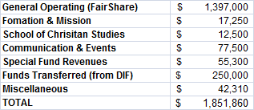
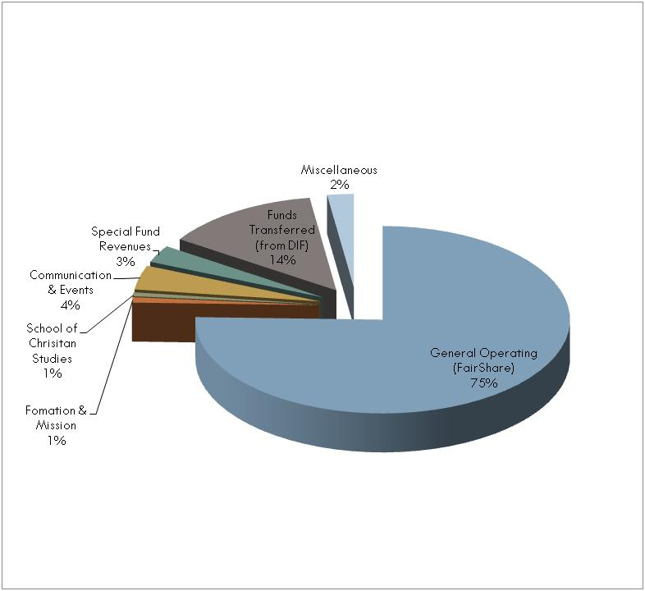
Revenue

Slide 8
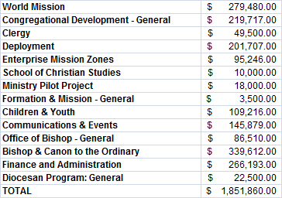
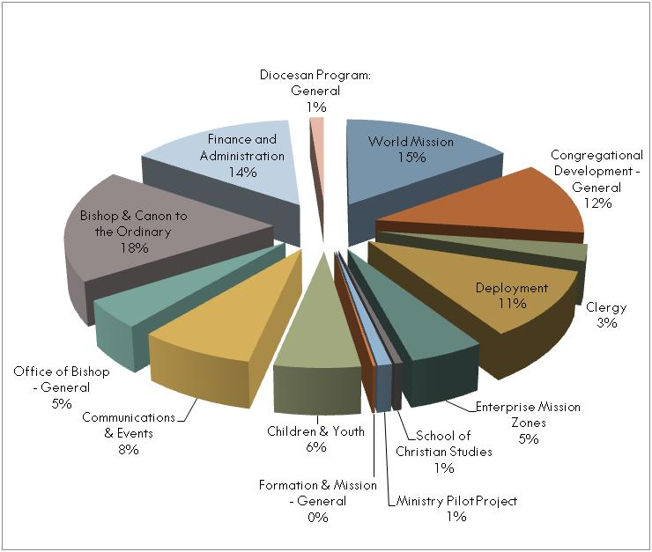
Expenses

